Slide 1
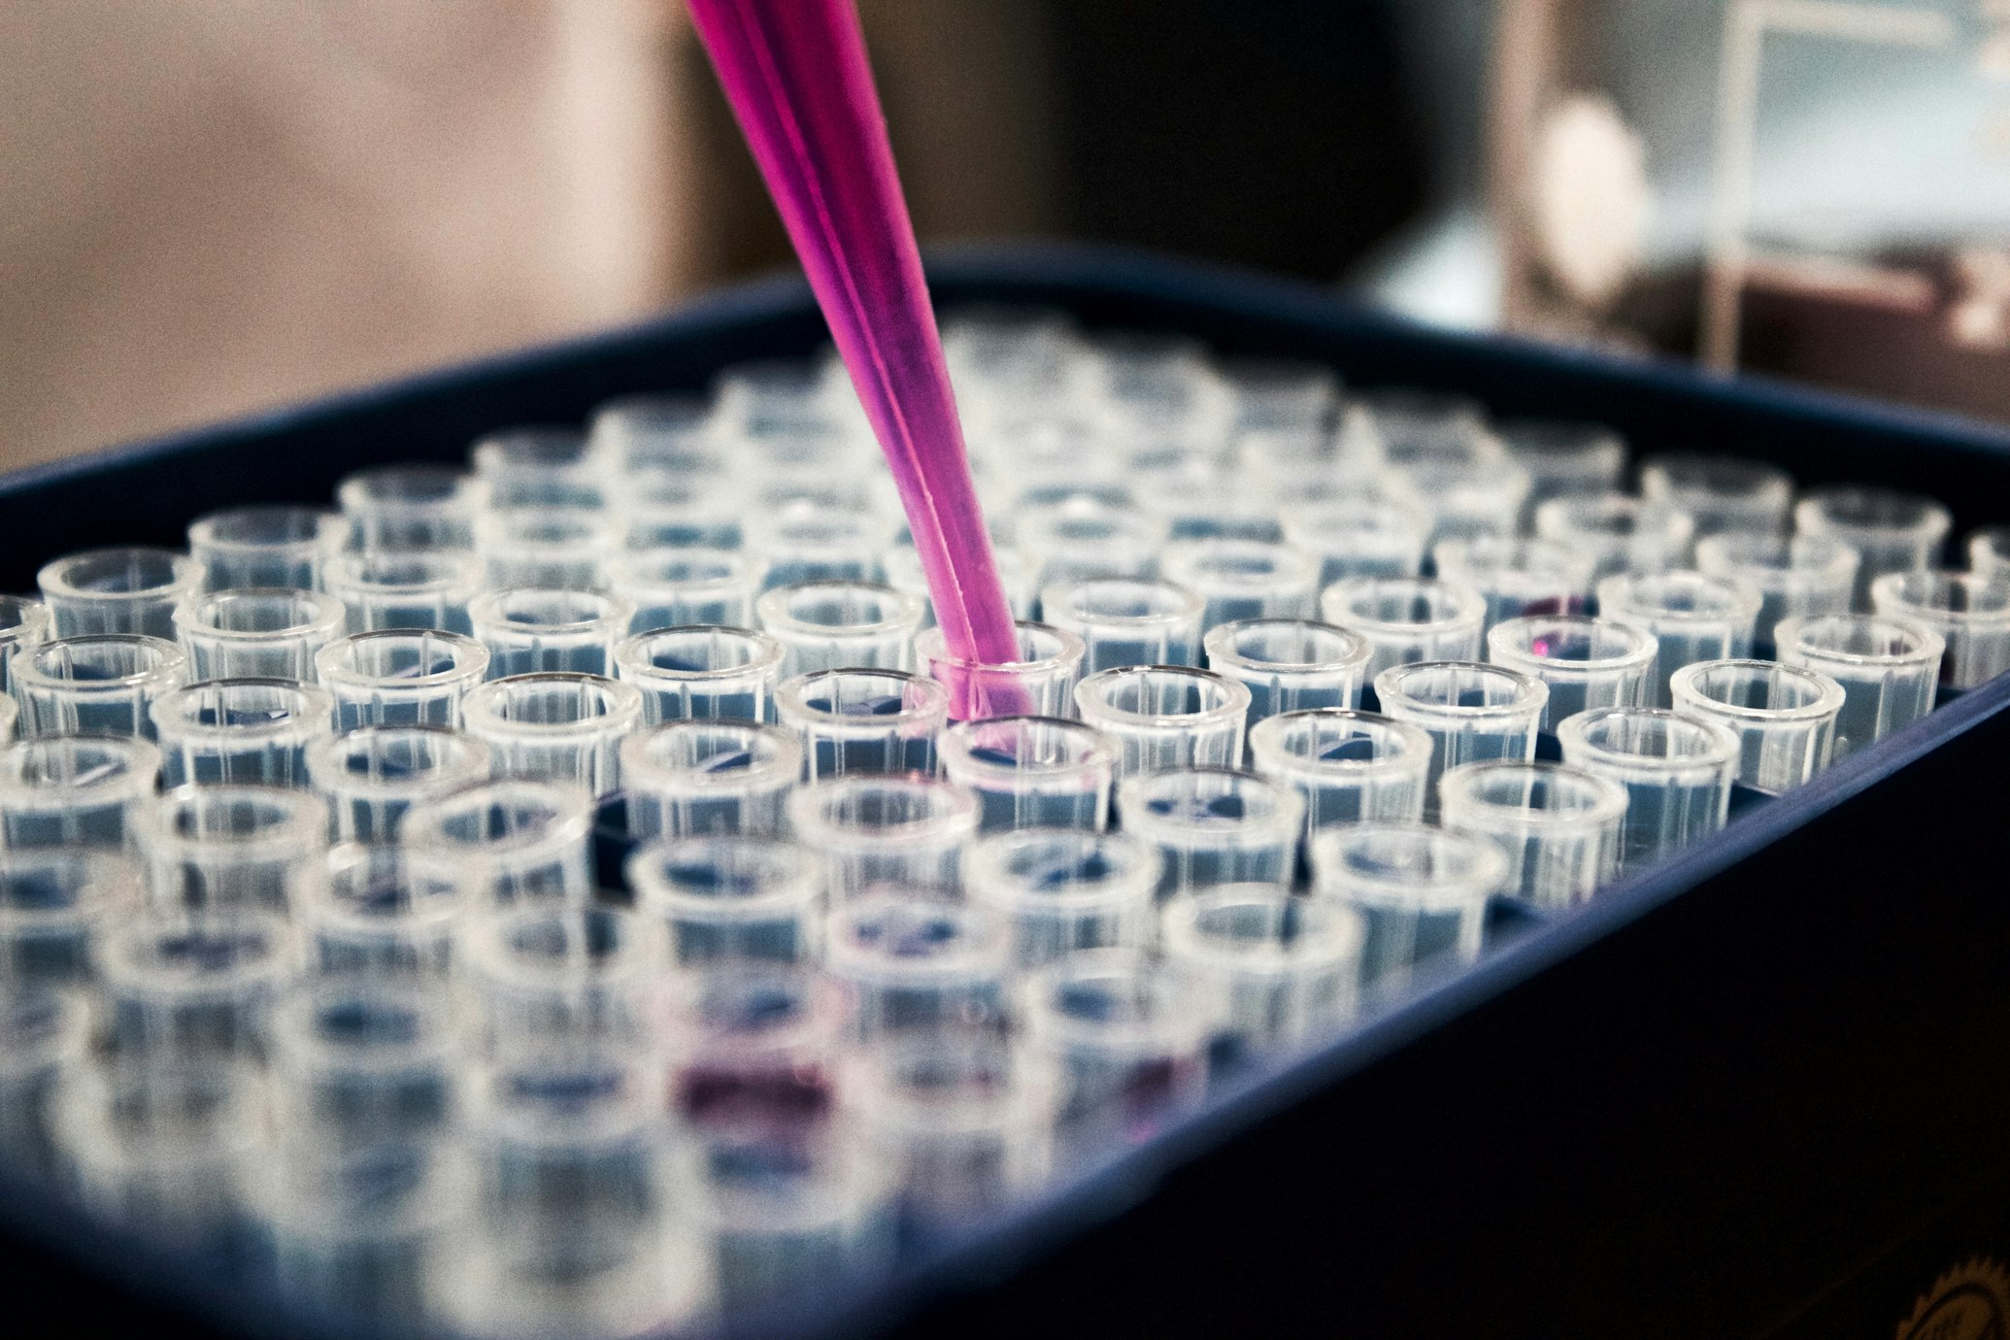
MPH 201T – MOLECULAR PHARMACEUTICS
TARGETED DRUG DELIVERY SYSTEMS
Concepts, Events and Biological Processes Involved in Drug Targeting
Presented by Tushar Mathapati
Dr. Y. Patil Pratishthan’s Dr. D. Patil College Of Pharmacy,Pune

Slide 2
01
02
Overview
The Problem
Core Concepts
Conventional drug therapy limitations.
Therapeutic index & targeting orders.
A comprehensive exploration of targeted drug delivery systems and their biological foundations.
03
04
Biological Events
Clinical Applications
Sequential targeting processes.
Current therapies & future directions.

Slide 3
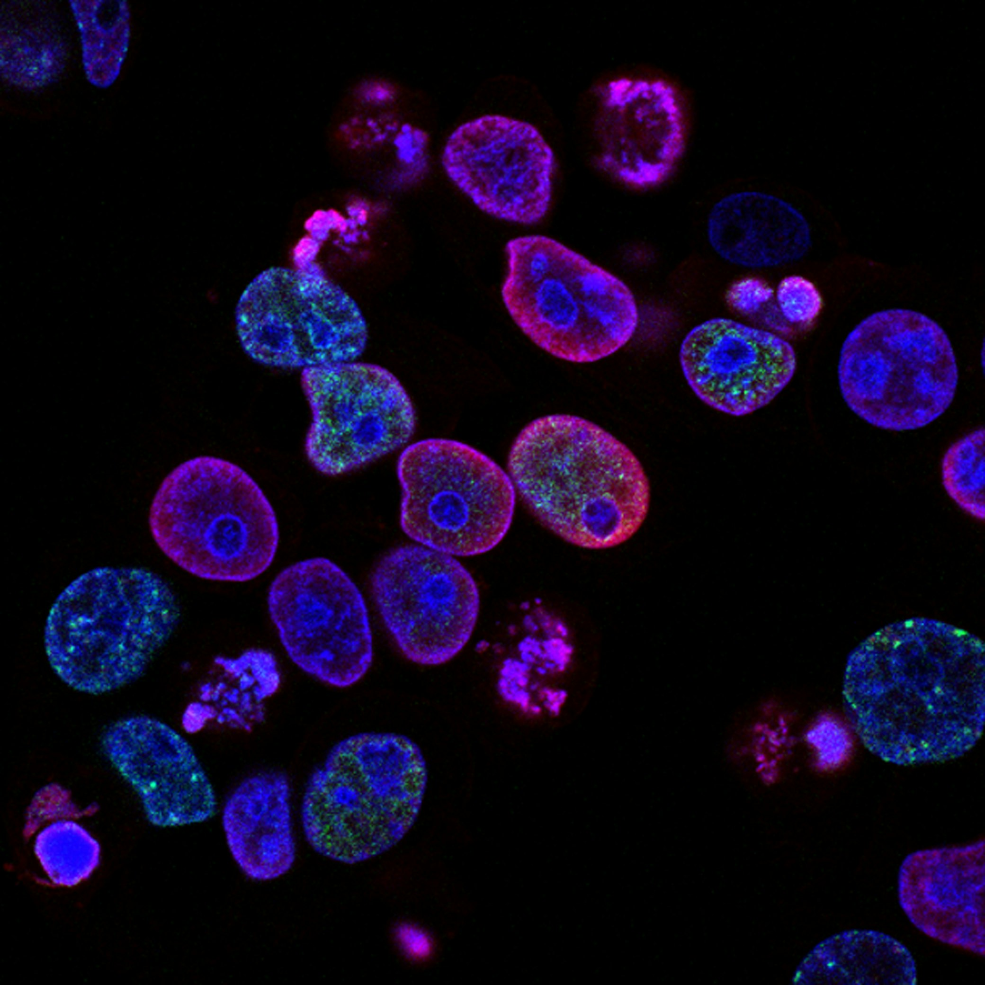
INTRODUCTION
The Fundamental Problem of Conventional Therapy
Conventional pharmacotherapy creates a paradox: therapeutic doses at target sites produce supratherapeutic concentrations at non-target tissues, leading to toxicity and reduced therapeutic indices.
TD50/ED50
100%
Therapeutic Index
Systemic Exposure

Slide 4


Core Concepts of Drug Targeting
Precision delivery to maximize efficacy and minimize toxicity
Definition & Scope
Therapeutic Index
Ability to direct therapeutic agent preferentially and specifically to desired anatomical site, organ, tissue, cell type, or subcellular compartment.
TI = TD50 / ED50
TD50
ED50
Toxic Dose
Effective Dose
"Ensuring pharmacologically active concentrations at target while minimizing non-target exposure"
Targeted delivery widens TI by creating concentration gradients: high at target site, low elsewhere.

Slide 5



Orders of Drug Targeting
Anatomical hierarchy of precision delivery
1st
2nd
3rd
First Order
Second Order
Third Order
Organ / Tissue Level
Specific Cell Type
Subcellular Organelle
Passive accumulation via fenestrated sinusoids; size-based retention
Receptor-ligand interaction; asialoglycoprotein receptor on hepatocytes
Signal peptide-mediated transport; pH-sensitive intracellular release
Example:
Example:
Example:
Nuclear targeting, Mitochondrial delivery
Liver-targeted drug delivery
Hepatocyte vs. Kupffer cell targeting

Slide 6

Active vs. Passive Targeting
The Critical Distinction
Passive Targeting
Active Targeting
Mechanism:
Mechanism:
Exploits pathophysiological abnormalities (EPR effect)
Ligand-receptor mediated preferential uptake
Selectivity:
Selectivity:
Tissue-level selectivity
Cell-level & receptor-level selectivity
Carrier:
Carrier:
Size & surface chemistry controlled nanoparticles
Ligand-conjugated nanoparticles (antibody, aptamer, folate)
Drug Release:
Drug Release:
Passive diffusion or microenvironment-triggered
Receptor-mediated endocytosis + intracellular release
Limitation:
Limitation:
Non-uniform EPR; heterogeneous tumors may not respond
Ligand immunogenicity; receptor saturation; manufacturing complexity
Example:
Example:
PEGylated liposomes (Doxil®) in tumors
Transferrin-conjugated nanoparticles for brain delivery

Slide 7


Enhanced Permeability & Retention
BIOLOGICAL BASIS
Vascular Architecture Comparison
Normal Tissue
Tumor Tissue
• Tight endothelium (5–7 nm gaps)
• Leaky endothelium (100–800 nm gaps)
The EPR effect, first described by Matsumura and Maeda in 1986, is the cornerstone biological phenomenon enabling passive tumor targeting.
• Functional lymphatics present
• Nanoparticles EXCLUDED
• Absent/non-functional lymphatics
• Rapid systemic clearance
• Nanoparticles EXTRAVASATE
• ACCUMULATE & RETAINED
10-50×
EPR Mechanism
Higher drug concentration in tumor vs. normal tissue
PERMEABILITY: Large gaps allow nanoparticle extravasation
RETENTION: No lymphatic drainage → accumulation

Slide 8
Factors Governing EPR Efficacy
Determinants of passive tumor targeting success
01
Tumor Type & Vascularization
02
Tumor Size
Highly vascularized tumors show stronger EPR effect. Dense stroma tumors exhibit compressed vasculature.
Larger tumors (>1 cm³) show more pronounced EPR effect due to increased leaky vasculature.
03
Nanoparticle Size
04
Surface PEGylation
Optimal range: 50–200 nm. <8 nm: renal clearance; >500 nm: MPS clearance.
Prolongs circulation half-life, allowing more extravasation opportunities in tumor tissue.
05
Interstitial Pressure
⚠
Critical Limitation
High interstitial fluid pressure in some tumors can impede extravasation of nanoparticles.
EPR is heterogeneous in human solid tumors. Fibrotic/desmoplastic tumors have compressed vasculature, impeding nanoparticle extravasation. This translational gap explains clinical trial failures.

Slide 9
EVENT 1
Systemic Circulation
Avoiding premature clearance & opsonization
Biological Events
EVENT 2
Vascular Transport
Extravasation at target site
Drug targeting is not a single event but a cascade of sequential biological events. Failure at any step compromises the entire targeting strategy.
EVENT 3
Target Site Recognition
Receptor-ligand interaction
EVENT 4
Cellular Internalization
Endocytic pathways
EVENT 5
"Understanding each event and its governing biological principles is what separates a pharmaceutical scientist from a formulator."
Endosomal Escape
Intracellular barrier
EVENT 6
Intracellular Trafficking
Subcellular targeting

Slide 10


EVENT 1
Systemic Circulation
Avoiding Premature Clearance
Clearance Mechanisms
Stealth Technology
Opsonization
Surface PEGylation creates hydrophilic brush layer preventing opsonin adsorption
Protein corona flags carrier as 'foreign' for MPS phagocytosis
Renal Filtration
01
PEG chains create steric repulsion
Particles <8 nm filtered by glomerular basement membrane
02
Blocks opsonin adsorption
Protein Adsorption
Evades MPS recognition
Non-specific binding alters size, charge, and ligand accessibility
03
Circulation Half-Life
vs Non-PEGylated
20-40
hours
Minutes

Slide 11


EVENT 2
Vascular Transport
Extravasation at the target site
Governing Factors
Endothelial Barrier Permeability
Hemodynamic Forces
Critical size constraints for extravasation:
Blood flow velocity & shear stress influence particle-endothelial contact probability
Blood-Brain Barrier
4–6 nm
Particle Size & Geometry
Tight junctions restrict most nanoparticles
Spherical particles 100–200 nm show optimal extravasation; rod-shaped particles have longer circulation
Tumor Vasculature
100–800 nm
Margination
Fenestrations allow nanoparticle extravasation
In post-capillary venules, nanoparticles marginate toward vessel walls, increasing endothelial interaction
Carrier design must match target organ vascular architecture

Slide 12


EVENT 3
Target Site Recognition
Receptor-Ligand Interaction
Ligand
Folate
Transferrin
Galactose
RGD peptide
Receptor
FR-α
TfR/CD71
ASGPR
Integrin αvβ3
Target
Cancer cells
Brain tumors
Hepatocytes
Tumor neovasculature
Biological Basis
Binding Affinity
Active targeting exploits overexpressed receptors on diseased cells. Molecular complementarity between targeting ligand and cognate receptor drives preferential uptake.
Quantified by dissociation constant (Kd). Lower Kd indicates stronger binding affinity.
Monoclonal Antibodies
Kd ~10⁻⁹–10⁻¹¹ M
100-300×
~500,000
FR-α overexpression on cancer cells
ASGPR receptors per hepatocyte
Aptamers
Kd ~10⁻⁹–10⁻¹² M

Slide 13




EVENT 4
Cellular Internalization
Endocytic Pathways
Clathrin-Mediated Endocytosis
Caveolae-Mediated Endocytosis
Predominant pathway for receptor-mediated uptake
Bypasses lysosomal degradation
~150 nm
Clathrin-coated pits
50-100 nm
Caveolin-1 rich
Pathway: Early endosomes → Late endosomes → Lysosomes
Ideal for acid-labile drugs and nucleic acids
Macropinocytosis
Phagocytosis
Non-specific, actin-driven membrane ruffling
Restricted to professional phagocytes
>1 μm
Large volume engulfment
>500 nm
Opsonized particles
Relevant for immune cell targeting
Relevant for MPS-targeted delivery strategies

Slide 14



EVENT 5
Endosomal Escape
The Intracellular Barrier
The Threat
Proton Sponge Effect
After endocytosis, cargo faces lysosomal degradation — over 50 hydrolytic enzymes active at pH 4.5–5.0 can destroy therapeutics within minutes.
Cationic polymers with high buffering capacity absorb protons pumped into the endosome, preventing acidification.
1
V-type H⁺-ATPases pump protons into endosome
Escape Strategies
2
Cationic polymers absorb protons, maintaining pH
3
Sustained proton influx causes osmotic swelling
01
02
Proton Sponge
pH-Responsive Peptides
Endosomal membrane ruptures, releasing cargo to cytoplasm
PEI, poly-L-histidine
GALA, KALA
4
03
04
Photochemical Internalization
Viral Fusion Proteins
Light-activated ROS
Hemagglutinin

Slide 15



EVENT 6
Intracellular Trafficking
Third-Order Subcellular Targeting
Nuclear Targeting
Mitochondrial Targeting
Lysosomal Targeting
Critical for gene therapy delivery. Nuclear envelope presents final barrier.
Deliberate routing for enzyme replacement therapies in lysosomal storage disorders.
Essential for treating mitochondrial disorders. Exploits electrochemical potential.
NLS Peptides
Targeting Signal
PKKKRKV (SV40 large T antigen)
MTS Peptides
Mannose-6-phosphate (M6P) receptors
Positively charged amphiphilic peptides
Transport Mechanism
Clinical Application
Importin-mediated shuttling
Driving Force
Enzyme replacement therapies
Δψm ≈ −180 mV across inner membrane
NPC Diameter
Key Advantage
~25 nm passive, ~39 nm active
TPP Conjugates
Direct therapeutic enzyme delivery
Triphenylphosphonium cation carriers

Slide 16



BIOLOGICAL BARRIERS
Governing Processes
Key biological systems affecting targeting outcomes
MPS Barrier
Complement Activation
Tumor Microenvironment
Mononuclear Phagocyte System is the primary clearance mechanism for foreign particles.
Exploitable pathophysiological conditions for stimuli-responsive drug release.
Immunological barrier triggering Complement Activation-Related Pseudoallergy (CARPA).
80-90%
Acidic pH
Hypoxia
3
6.5-6.8
pO₂ < 5 mmHg
Phagocytic capacity from Kupffer cells
Activation pathways
Elevated ROS
High GSH
H₂O₂ rich
~10 mM intracellular
Key Components:
Pathways:
Targeting Strategy:
Monocytes, Macrophages, Dendritic cells
Classical, Alternative, Lectin
Stimuli-responsive release systems

Slide 17
ABC Transporters
Multidrug Resistance
P-gp/ABCB1
MRP1/ABCC1
BCRP/ABCG2
Primary efflux pump
Multidrug resistance
protein
Breast cancer resistance protein
The cellular efflux barrier undermines even perfectly targeted drug delivery.
Circumvention Strategies
1
Endocytic Internalization
Nanocarriers bypass membrane transporters; release drug deep in cytoplasm
10-100×
Co-delivery of P-gp Inhibitors
2
Reduction in intracellular drug concentration
Simultaneous delivery ensures pharmacological synergy at cellular level
40-50% of chemotherapy-resistant cancers overexpress ABC transporters

Slide 18





Physicochemical Parameters
Key determinants of targeting efficiency
Particle Size
Zeta Potential
Surface Hydrophilicity
50–200 nm
−20 to −30 mV
High (PEGylation)
Tumor targeting: 50–200 nm
Stable anionic or highly cationic
Hydrophilic steric brush layer
BBB crossing: <100 nm
−10 to +10 mV: Aggregation risk
Hydrophobic surfaces: Rapid opsonization
Highly cationic: Hemolysis, cytotoxicity
Kupffer cell uptake, short half-life
<8 nm: Renal clearance
>500 nm: MPS phagocytosis
Encapsulation Efficiency
Drug Release Rate
Ligand Density
>70%
Controlled
Optimal
Ideally high drug loading
Stimulus-responsive release
Not saturating concentration
Low EE: Dose escalation required
Burst release: Off-target toxicity
Too high: Steric hindrance between ligands
Free drug causes off-target toxicity
Too slow: Subtherapeutic levels
Too low: Insufficient multivalent binding

Slide 19






Pharmacokinetic Consequences
How targeting alters PK parameters
Volume of Distribution (Vd)
Area Under Curve (AUC)
250
10-100
×
Reduction in Vd
Higher tumor AUC
Free doxorubicin: ~700 L/kg
×
Liposomal: ~2.8 L/kg
Compared to equivalent free drug doses
Biodistribution
Circulation Half-Life (t½)
20-45
Successful active targeting shows:
hrs
Extended with PEGylation
vs. minutes for conventional nanoparticles
Target organ concentration
Off-target organ exposure

Slide 20
Ideal Requirements
Essential criteria for clinical translation
01
Biocompatibility
02
Biodegradability
03
Stability
Non-toxic, non-immunogenic, non-pyrogenic, non-thrombogenic in therapeutic concentrations
Degrade into non-toxic, excretable products upon fulfilling delivery function
Maintain structural integrity during storage, circulation, and transit through biological fluids
04
Target Specificity
05
Controlled Release
06
Scalability
High selectivity for pathological tissue with minimal interaction with healthy cells
Drug release at target site at rate and duration maintaining therapeutic concentration without toxic peaks
Manufacturing process scalable with consistent particle size distribution, drug loading, and surface functionalization
07
Adequate Drug Payload
Sufficient drug encapsulation to achieve therapeutic doses — particularly challenging for macromolecular carriers

Slide 21





Clinically Approved Examples
Translational proof of concept
Doxil®
Abraxane®
Kadcyla®
DaunoXome®
Onpattro®
Doxorubicin
Paclitaxel
DM1 (maytansinoid)
Daunorubicin
siRNA
Passive EPR + Stealth
Passive + SPARC
Active HER2
Passive EPR
Active GalNAc
Ovarian cancer, Kaposi's
sarcoma
Breast, lung, pancreatic
cancer
HER2+ breast cancer
Kaposi's sarcoma
Hereditary ATTR
amyloidosis
Antibody-drug conjugate
Non-PEGylated liposome
First FDA-approved siRNA (2018)
PEGylated liposome
Albumin nanoparticles

Slide 22


Limitations & Future Directions
Challenges and emerging frontiers
Unresolved Challenges
Emerging Frontiers
Heterogeneous EPR effect in human solid tumors
Personalized targeting via patient-specific profiling
1
1
Protein corona alters surface identity & targeting
Exosome-based delivery with low immunogenicity
2
2
Scale-up challenges & batch-to-batch variability
Multi-trigger systems requiring multiple stimuli
3
3
Anti-PEG antibodies cause accelerated blood clearance
AI in targeting design for rational ligand selection
4
4

Slide 23
References
Jain NK. Controlled and novel drug delivery. 1st ed. New Delhi: CBS Publishers & Distributors; 1997.
Jain NK. Controlled and novel drug delivery. 1st ed. New Delhi: CBS Publishers & Distributors; 1997.
Vyas SP, Khar RK. Controlled drug delivery: concepts and advances. New Delhi: Vallabh Prakashan; 2002.
Chien YW. Novel drug delivery systems. 2nd ed. New York: Marcel Dekker; 1992.
Allen TM, Cullis PR. Drug delivery systems: entering the mainstream. Science. 2004;303(5665):1818-22.
ain RK, Stylianopoulos T. Delivering nanomedicine to solid tumors. Nat Rev Clin Oncol. 2010;7(11):653-64.
Torchilin VP. Multifunctional, stimuli-sensitive nanoparticulate systems for drug delivery. Nat Rev Drug Discovery. 2014;13(11):813-27.
Matsumura Y, Maeda H. A new concept for macromolecular therapeutics in cancer chemotherapy: mechanism of tumoritropic accumulation of proteins and the antitumor agent smancs. Cancer Res. 1986;46(12):6387-92.

Slide 24

Thank You
"Targeted drug delivery is fundamentally a biological problem masquerading as a pharmaceutical one."
Presenter
Course
Tushar Mathapati
MPH 201T – Molecular Pharmaceutics

